Slide 1
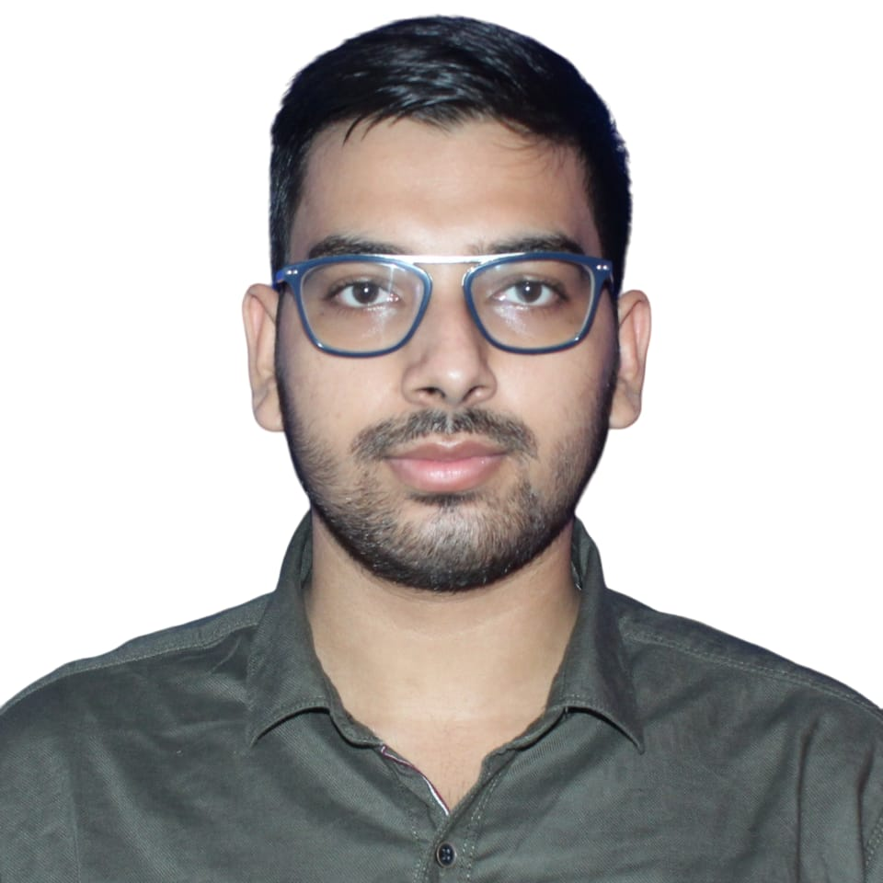
Abhishek Sharma
Analyst/Software Engineer
Bachelor of Engineering,
Information Science and Engineering: 2018-22
MUMBAI
Skills
abhishek.aw.sharma@capgemini.com
JAVA | Basics, OOPS, Exception Handling, Arrays
C, C++, Python | Basics
Database | SQL(MySQL), NoSQL(MongoDB)
Backend | Spring Boot, Spring Core, Spring Web Service, REST-API
Tools | Eclipse, Visual Studio Code, POSTMAN
Web Technologies | HTML5, CSS & React JS
Add On Skills | Communication Skills, Team Management, Self Learner
+91 7903316841
A
Full Stack JAVA Developer
Practical understanding of Java, C, C++, SQL and NoSQL concepts
Hands on experience in Java Microservice Development using Spring Boot, API Gateway and MongoDB
Ready to learn new technologies/Frameworks and implement them to further improve my knowledge
Good understanding in concepts of Data structure.
Understanding of HTML5, CSS and React JS.
Completed a case study:
On Demand Car Wash Application is a Web-based Car Wash Management System that leads to perform management of car wash, customer and washer details. It handles car wash bookings and relevant services. It is implemented using Spring Boot Microservices with Eureka Server. React JS is used for user interface.
Technologies used:
Java
React JS
Spring Boot

